Slide 1
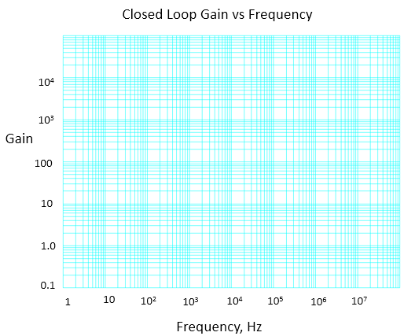
ECSE 371 Lab #2, Operational Amplifiers V23.0
Please carefully review H&H, Ch. 4.1, 4.1.2, 4.1.3, 4.2.1, 4.2.2. 4.2.3, 4.2.4, 4.2.6 .2.7, 4.4.1 (all), 4.4.2 (all).
On Canvas see: “Op-Amp Tutorial”, “Op-Amp Slew Rate”, as well as the excellent reference in Modules, “Op-Amps for Everyone”, Ch. 1 thru 4. Also, Hands-On Electronics, Ch. 3.2 thru 3.5 and Ch.7.
Provide a Saturday schematic for Part III and Part IV. See NOTES * on last page.
I Warm-Up Exercise -When op amps are not "ideal"
1. Build an inverting amplifier with a 741 op amp. Design for a gain of 100 and an input impedance (or resistance) of 1KΩ. Operate on a +/- 15.0 V power supply. Be sure to review “Solderless Breadboard Set-Up” in Modules; please carefully follow the suggestions!!
2. With Vin = 0 (input tied to ground), measure and record the DC output voltage with a DMM. What voltage do you expect, and what do you measure? Can you explain? _____________________________
___________________________________________________________________________________
3. Provide a 0.10 V_{pp} 10KHz sinewave input*. Measure and record the gain of the amplifier and explain why the gain does not equal 100. (Don’t blame resistor values!!!! you can be confident that they are well within tolerance). _________________________________________________________________
_______________________________________________________________________________________
_______________________________________________________________________________________
4. With a 0.10 V_{pp} sinewave input, measure and plot the frequency response of your amplifier circuit from 10Hz to 100KHz; you may manually plot the data below or use Excel to plot. Or you may use the nifty Analyze/Frequency Response Analysis feature on the 3014 oscilloscopes. Set "points" to 50 or 100 to decrease the plotting time. For your recitation, please make available your plot or a scope screenshot.
5. With a 0.10 V_{pp} 1KHz sinewave input, slowly increase the input voltage as you observe the amplifier output waveform; look for saturation. Measure and record the maximum positive and negative voltage swings: V+max_______________ V-max_______________
6. Why is output voltage swing important? _________________________________________________ _______________________________________________________________________________

Slide 2
Op-Amp Specifications
Constructing circuits as needed, carefully measure (and where necessary, perform the related calculations) to determine the specifications for a 741 op amp as listed below. Mark or tag the specific 741 that you are testing so it doesn’t get lost; it will be used again. Please note that properly taking these measurements might be difficult and will require some careful thought. Record your answers on the lines below, including the proper units. For recitation, please have your results available, along with the specific op-amp you tested. For each measurement, provide a circuit diagram, graphs, and other information that explains how the measurement was taken. Be sure to show units where appropriate.
Note that Slew Rate is a large-signal parameter, measured at unity gain, and measured with a 5KHz or 10 KHz square wave input adjusted to produce a very large (almost rail-to-rail) signal swing at the output.
Input Offset Voltage, V_{io} _________
Input Bias Current, positive input I_{ib+} _________
Input Bias Current, negative input I_{ib-} _________
Input Bias Current, average I_{ib} _________
Input Offset Current I_{io} _________
Output Short Circuit Current I_{sc} __________
Gain bandwidth Product GBP ________
9. Slew Rate SR _________
Note that these test results represent parameters for your particular op amp and must be independent of the specific circuit that you use for measurement purposes.
The manufacturer’s values for these specifications are published in the op amp data sheet; compare your results to these values. If your values do not fall within the range of the listed specifications, you're probably doing something wrong and you should check your approach and your results.
Gently heat your op amp with the hair dryer available in the lab. What is the effect on offset voltage and bias current? ____________________________________________________________________
___________________________________________________________________________
What is the direction of bias current?
_____________________________
_____________________________
Design Project 1 – Design Only!
Design (you do not have to build) an op amp circuit with three inputs (VA, VB, and VC), one output (Vout), and a single switch or jumper.
With the switch or jumper closed: Vout = (VA + 2VB + VC/2)
With the switch or jumper open: Vout = 2(VA + 2VB + VC/2)
The inputs will vary between +1 and -1 Vdc and will be supplied by voltage sources with an internal resistance of 50 ohms. Design using 741 op amp(s); operate on +/_ 15V.
Will your circuit work properly if the inputs are allowed to vary between +3 and -3 Vdc?
Prepare a schematic for Saturday.
If you have time: Design a circuit that operates in the opposite sense: In other words, Vout will double when the jumper is closed instead of when it is open. Prepare a schematic for recitation.

Slide 3
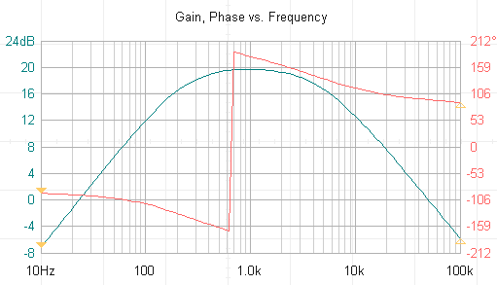
Design Project 2. Provide a Saturday schematic of this circuit.
Design, build, and test an inverting or non-inverting amplifier with a frequency response approximately as shown below. The amplifier will have a gain of 10 (20dB) at the center frequency, fc = 1 kHz; the gain will drop by 3dB at ~200 Hz and above ~ 5 kHz. Beyond these points, the gain will continue to drop about 20 dB per decade. The circuit input will be provided by a sine-wave generator with the standard 50 ohms internal resistance; the circuit output will drive an oscilloscope. Use a 741 op amp operating on a +/-15V supply.
When initially thinking about the circuit configuration, it will be helpful to remember how capacitors behave at very high and very low frequencies. After that, you can begin to think about calculating values.
This plot is from the Frequency Response Analysis on the DSOX. It is a good example of a measurement that requires interpretation. The phase measurement (in red) doesn’t make sense because of the way the scope displays phase angles that exceed 180⁰.
You may reliably measure phase by simply using 2 channels to compare the input and output waveforms, using the cursors to measure the delay, and calculating the shift in degrees. but what will the phase shift be at fc? _______________
*PLEASE READ before you start this lab:
1. On many function generators, including the ones in our lab and the one built into the 3014 oscilloscope, the generator's output- voltage digital display can be tricky to use. It is absolutely crucial to understand the limitations of this meter. It is connected to the generator output, but before the generator’s series resistance. Therefore, it does NOT display the output voltage that appears at the generator's output terminals. Huge inaccuracies may also result because of waveform variations and distortion. Always ignore this display!! It is rarely of value.
2. On some generators, such as our Agilent model, you may not be able to set the output-voltage amplitude low enough for certain applications. Fortunately, some generators, such as the small TTI generators available in the lab, contain a calibrated "step attenuator" which allows you to accurately reduce the generator output down to the millivolt range. With the attenuator rotated clockwise (to “zero” or “20 dB” attenuation), you can observe the generator output at a relatively high level which permits the oscilloscope (or, in some cases, an external DMM) to accurately display and measure the waveform. Then, you can decrease the generator output in precise steps of 20 dB (10X) to provide the small amplitude that you need. The generator’s variable "vernier" control provides fine amplitude adjustment.
Regarding the oscilloscope MEASURE features: Be very careful when using these functions. They are notably unreliable, especially on amplitude measurements. ALWAYS MANUALLY COUNT GRID DIVISIONS AS A SANITY CHECK ON THE ACCURACY OF THE MEASURE FUNCTION: For example, the peak-to-peak "measure" function is often inaccurate because slight peaks or glitches may be added to the measured value. Also, the measurement function is subject to huge errors when signal amplitudes are below several hundred millivolts. In general, is usually much quicker and safer to simply count grid divisions then to use oscilloscope the measurement functions; the resolution that you obtain is suitable for the vast majority of measurement requirements.
If Spock has pointy ears, what kind of ears does Scotty have?
Also note that the maximum output amplitude of the 3014 oscilloscope internal waveform generator is only 5V.this generator has several other limitations as well; for example, it cannot produce a single-pulse output.
Provide a Saturday schematic for Part III and Part IV.
Engineers!!

Slide 4
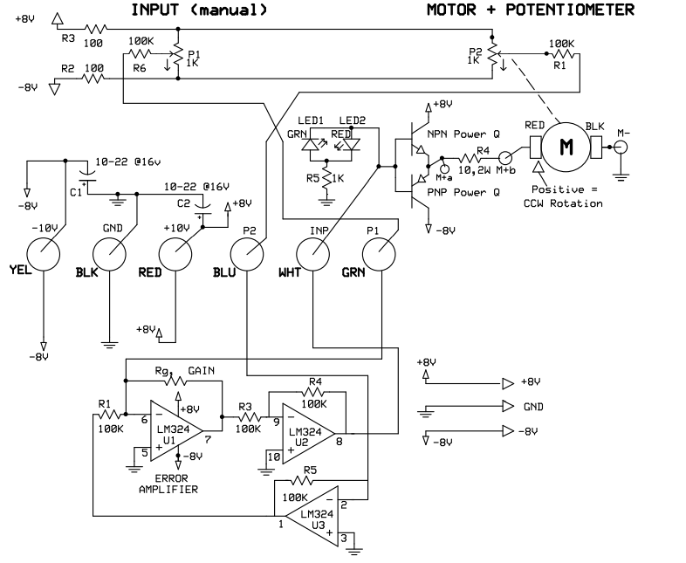
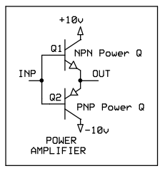
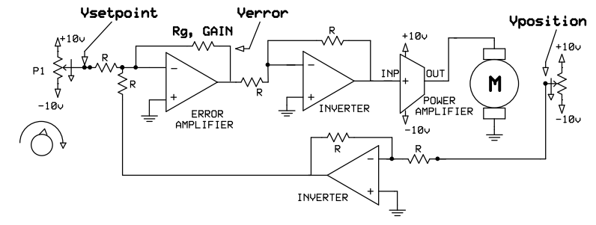
V. SERVO POSITION CONTROL. Build the breadboard shown below; you will use an LM324 quad op amp. The entire system (PCB and breadboard) will be powered by the +/- 8V split supply. CHECK YOUR WIRING! DO NOT ATTEMPT TO MANUALLY ROTATE THE MOTOR KNOB!!!
With the gain resistor, Rg, at 680K, rotate the manual position control (setpoint pot) about 30° and observe that the motor and pot rotate the identical amount.
Record your observations with Rg = 220K, 2.2Meg, and 10Meg.
Supplied PCB
To
Bench Supply
4
11
Your Breadboard
Block Diagram
2/2

